Slide 1
Human Resources Analytics Dashboard
A Data-Driven Approach to Workforce Optimization
Prepared by: Abinesh S P

Slide 2
Project Objective
• Analyze HR data to improve workforce efficiency
• Track recruitment, attrition, and employee performance
• Enable data-driven decision making
• Forecast hiring needs using predictive analytics

Slide 3
Key HR Metrics
• Employee Count & Active Workforce
• Attrition Rate
• Recruitment Metrics (Hiring Rate, Time-to-Hire)
• Employee Satisfaction Score
• Performance Ratings
• Department-wise Distribution

Slide 4
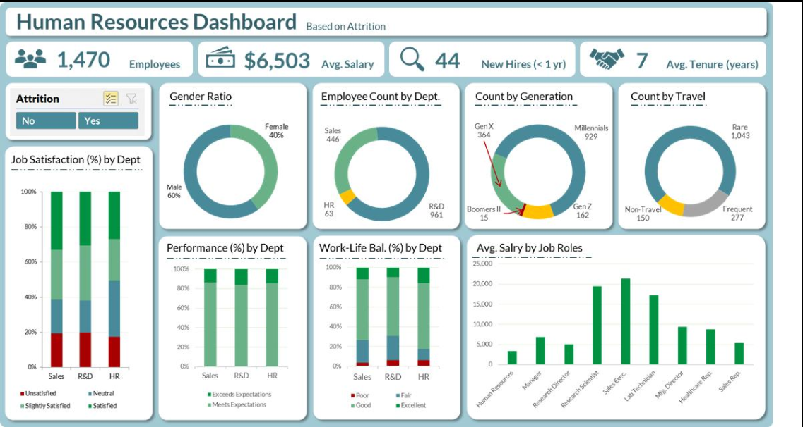
HR Overview Dashboard

Slide 5
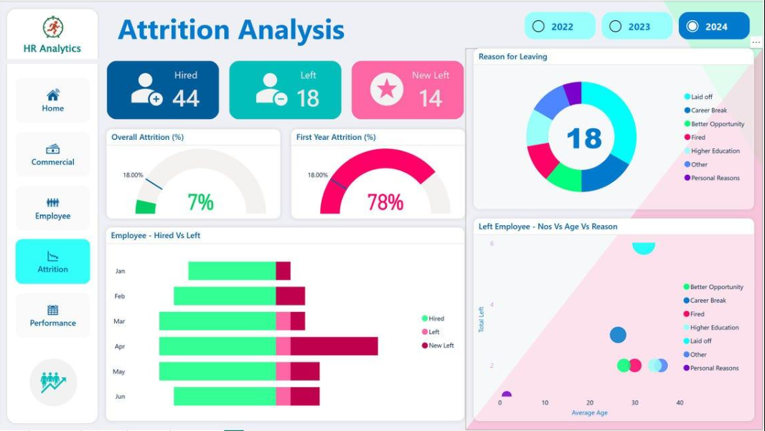
Attrition Analysis

Slide 6
Key Insights
• Higher attrition observed in specific departments
• Employees with lower satisfaction scores are more likely to leave
• Recruitment efficiency impacts workforce stability
• Performance and retention are strongly correlated

Slide 7
Predictive Analytics
• Forecast hiring needs based on historical trends
• Identify employees at risk of attrition
• Improve workforce planning strategies
• Optimize recruitment pipelines

Slide 8
Conclusion
• HR Analytics enables smarter decision-making
• Improves employee retention and satisfaction
• Supports strategic workforce planning
• Provides actionable insights for organizational growth

